Slide 1
EP Color in the Pharma Industry

Slide 2
What is EP Color?
There 5 Pharmacopoeia Color scales in use worldwide – USP (US), EP (Europe), BP (UK), JP (Japan) and CP (China).
Visual EP - European Pharmacopoeia Liquid Color Standard
3 primary solutions (yellow, red and blue) combined with hydrochloric acid to make 5 standard solutions (B (brown), BY (brownish-yellow), Y (yellow), GY (greenish-yellow) and R (red) further diluted with hydrochloric acid to make 37 reference EP color standards - 9B, 7BY, 7Y, 7GY and 7R.
Notes:
EP - European Pharmacopoeia, Section 2.2 Physical and Physico-Chemical Methods, Unit European Pharmacopeia, Strasbourg, France www.pheur.org
Section 2.2.2 Degree of Coloration of Liquids provides definition and preparation of the 37 EP liquid color standards for use as visual color standards for transparent pharmaceutical products

Slide 3
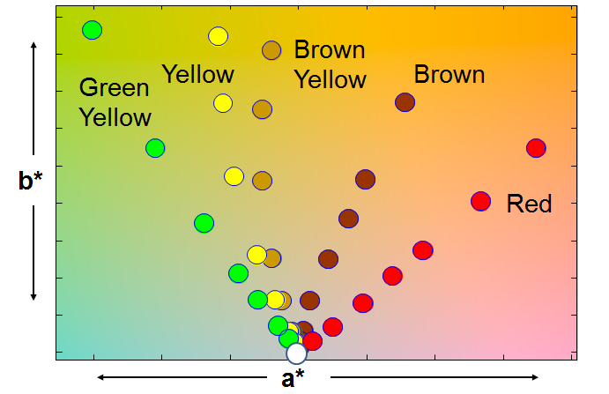
EP Color Standards

Slide 4
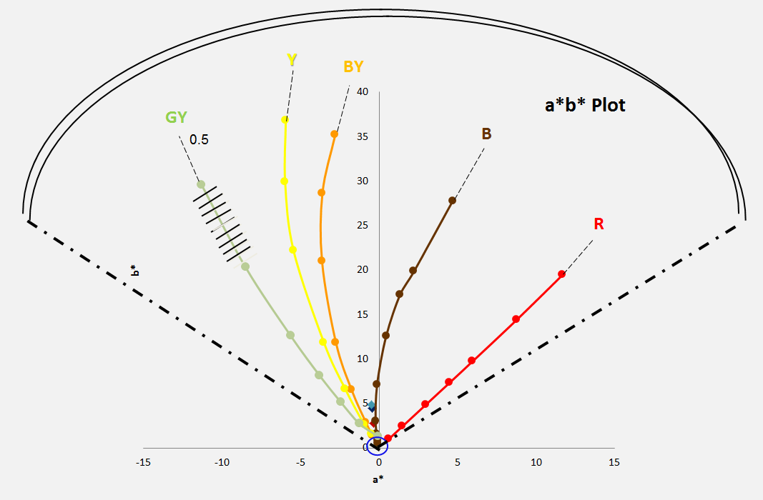
How Do We Measure EP Color with EasyMatch QC?

Slide 5
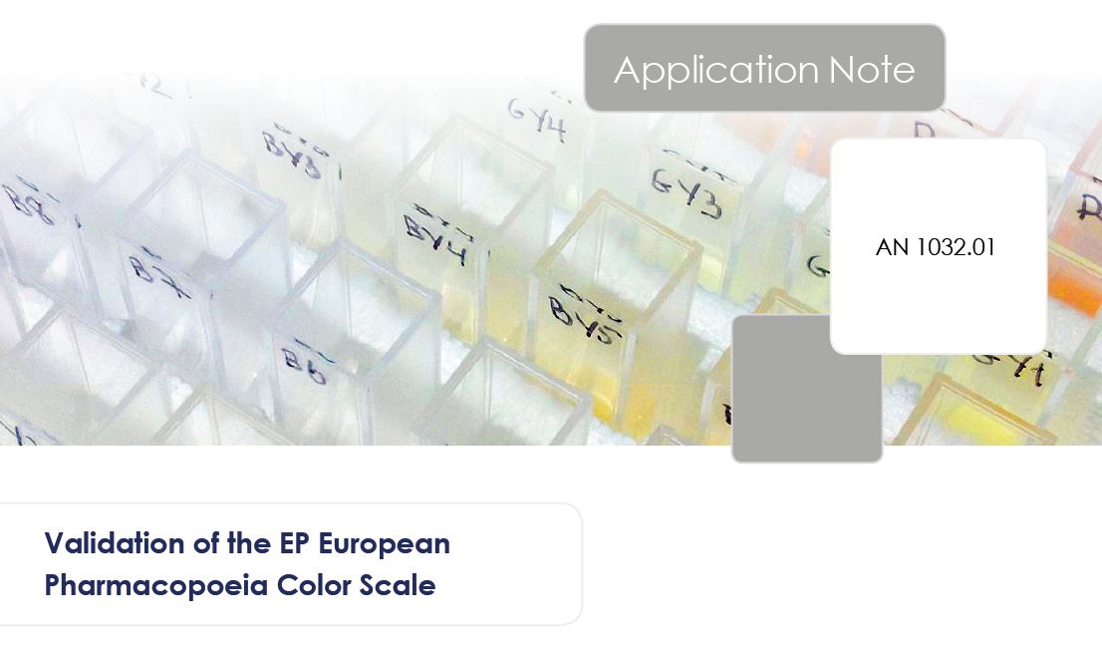
Our Validation Method

Slide 6
What is the importance of Instrumental EP Color Measurement?
The basis for EP Color is visual but inherently subjective.
Pharma likes objective and quantifiable metrics with defined measurement protocols.
Our instruments and software is easy to use compared to other equipment.
EasyMatch QC-ER is available as an option.
There is more we can do for them…

Slide 7
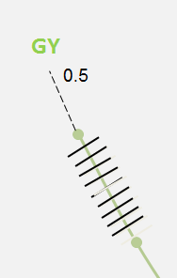
Moving Forward
Enhanced correlation to EP Color to report to tenths if a unit such as EPGY 1.6

Slide 8
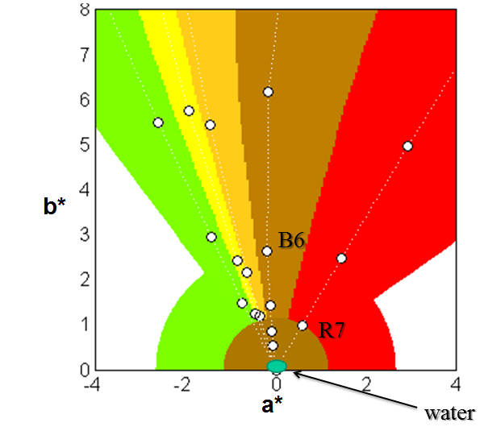
Single Hue EP Color

Slide 9
Chinese Pharmacopoeia Color Scale
50 color standards in 5 hue lines
  Yellowish green (YG1 - YG10)
  Yellow (Y1 - Y10)
  Orange Yellow (OY1 - OY10)
  Orange Red (OR1 - OR10)
  Brownish Red (BR1- BR10)
  Different but similar to EP Color
Notes:
The Chinese Pharmacopoeia Color Scale for grading pharmaceutical solutions is divided into five color series of 10 liquid color standards each for a total of 50 standards: Yellowish green (YG1 - YG10); Yellow (Y1 - Y10); Orange Yellow (OY1 - OY10); Orange Red (OR1 - OR10); Brownish Red (BR1 - BR10).
It is most similar to the EP Pharmacopoeia in having liquid color standards arranged along 5 distinct hue lines radiating out from distilled water but with 50 color standards instead of 37 for EP Color.

Slide 10
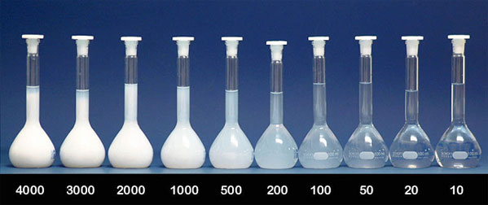
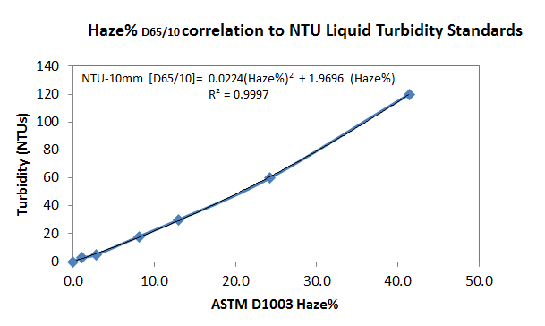
Haze% correlation to NTU

Slide 11
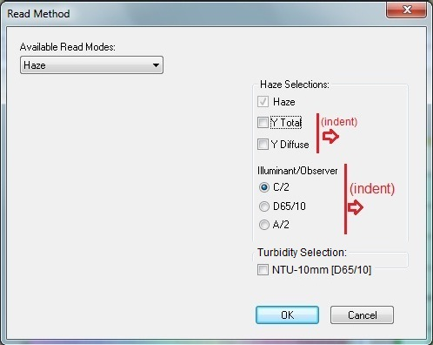
Haze% and NTU

Slide 12
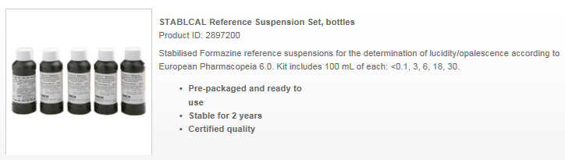
EP Opalescence
Haze% correlation to EP Opalescence and NTU
Table 2.2.1-1 EPOP Standards | 0 | I | II | III | IV
Formazin Standard of Opalescence (60 NTU) | 0.0 ml | 5.0 ml | 10.0 ml | 30.0 ml | 50.0 ml
Distilled Water (fill to 100.0 ml mark) | 100.0 ml | 95.0 ml | 90.0 ml | 70.0 ml | 50.0 ml
NTU Rating | 0 | 3 | 6 | 18 | 30

Slide 13
EP Opalescence
Haze% correlation to EP Opalescence and NTU

Slide 14
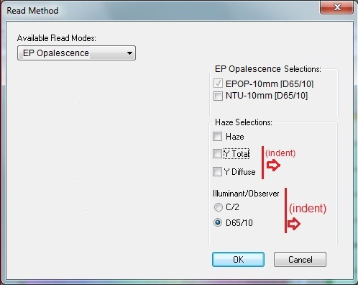
EP Opalescence

Slide 15
Discussion?

